Slide 1
WATER MANAGEMENT IN SERBIA
Olivera Gavrilović
Public Water Management Company ’’Vode Vojvodine’’
Workshop on innovative practices in the EU water sector: barriers and opportunities / 8/5/2019
This project has been funded with support from the European Commission. This publication reflects the views only of the author, and the Commission cannot be held responsible for any use which may be made of the information contained therein.

Slide 2
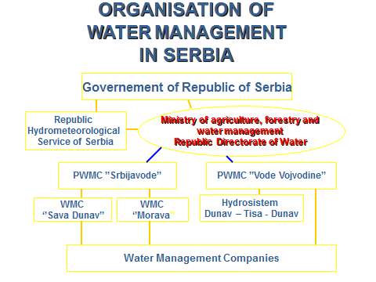
Strengthening of master curricula in water resources management
for the Western Balkans HEIs and stakeholders
www.swarm.ni.ac.rs

Slide 3
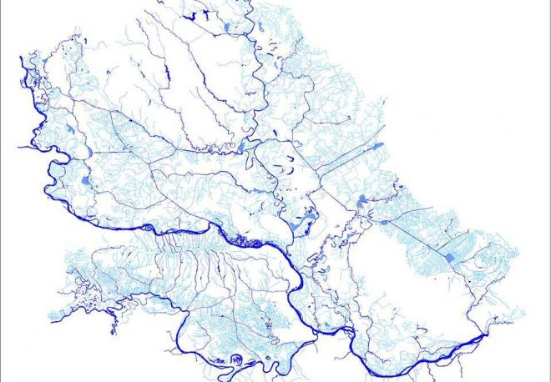
PUBLIC WATER MANAGEMENT COMPANY VODE VOJVODINE
PUBLIC WATER MANAGEMENT COMPANY VODE VOJVODINE WAS FOUNDED IN 2003 TO TAKE RESPONSIBILITY OVER WATER RESOURCES ON THE TERRITORY OF AP VOJVODINA
  Total area of 21,506 km2
  Population around 2,000,000
ACTIVITIES OF PWMC VODE
VOJVODINE
FLOOD PROTECTION
  Flood control
  Drainage
WATER USE
  Irrigation
  Water supply
  Navigation
  Fishery
  Recreation and tourism
WATER PROTECTION
Strengthening of master curricula in water resources management
for the Western Balkans HEIs and stakeholders
www.swarm.ni.ac.rs

Slide 4
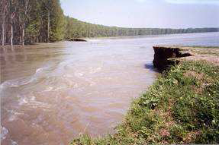
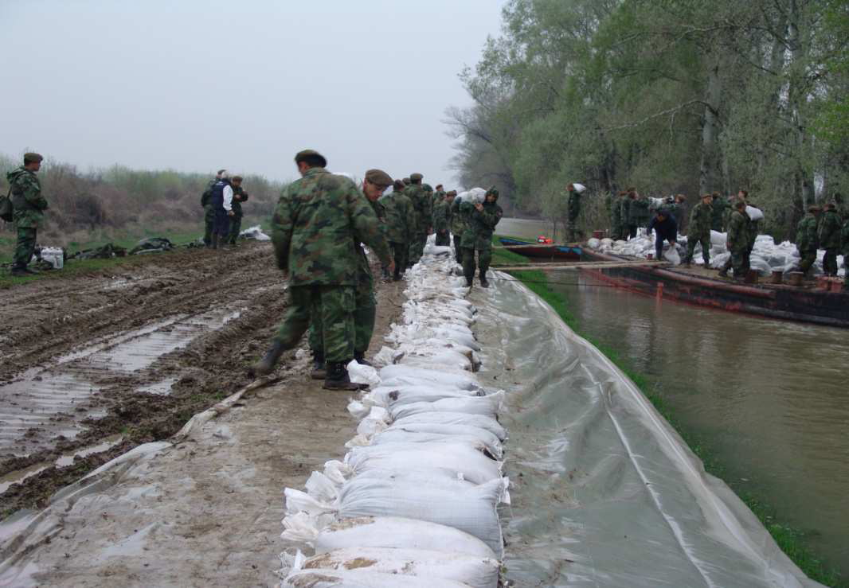
FLOOD PROTECTION
Threatened by 1% probability flood
waters :
1,000,000 ha (45% of the total area)
260 settlements
1,200,000 inhabitants
3,480 km of roads and 150 km of
railway
800 industrial plants and facilities
Total length of the embankments
1459,11 km
Danube 304,16 km
Tisza 290 km
Sava 120 km
Timiș 86 km
Old and New Bega 127,79 km
Border enbankments 84,78 km
Other 446,94 km
Strengthening of master curricula in water resources management
for the Western Balkans HEIs and stakeholders
www.swarm.ni.ac.rs

Slide 5
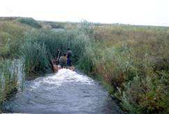
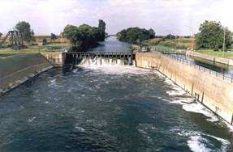
PROTECTION OF VOJVODINA AGAINST INLAND WATERS – DRAINAGE
Over 80% of Vojvodina is threatened by
inland waters
directly threatened – 1,630,648 ha
partially threatened – 209,423 ha
Drained areas
Bačka and Banat District 1,423,076 ha
Srem District 353,433 ha
Existing drainage systems:
Total length of canals - 20,094 km
Number of systems – 303
Pumping stations -159 with capacity of 437 m3/s
Strengthening of master curricula in water resources management
for the Western Balkans HEIs and stakeholders
www.swarm.ni.ac.rs

Slide 6
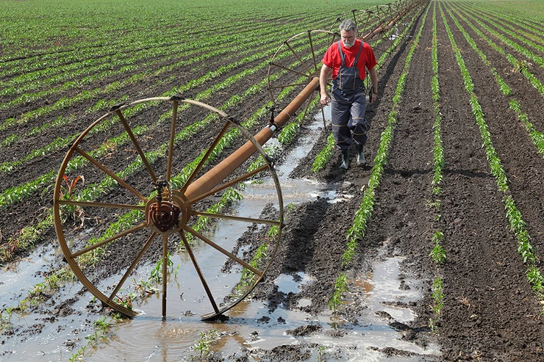
IRRIGATION IN VOJVODINA
Area available for irrigation
in Vojvodina:
in Bačka 350,000 ha
in Banat 402,000 ha
in Srem 184,000 ha
Strengthening of master curricula in water resources management
for the Western Balkans HEIs and stakeholders
www.swarm.ni.ac.rs

Slide 7
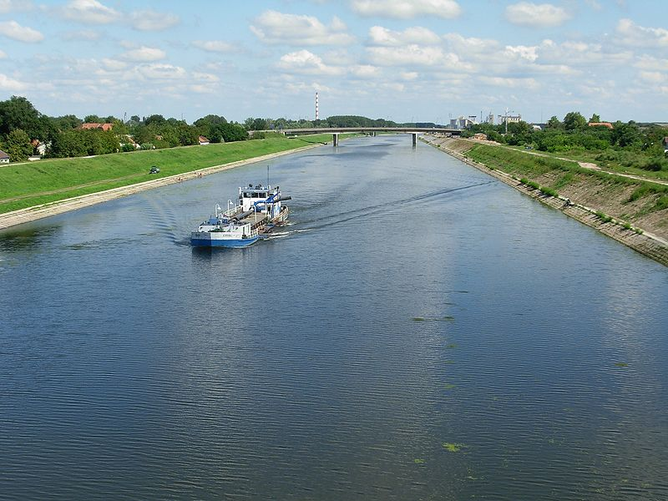
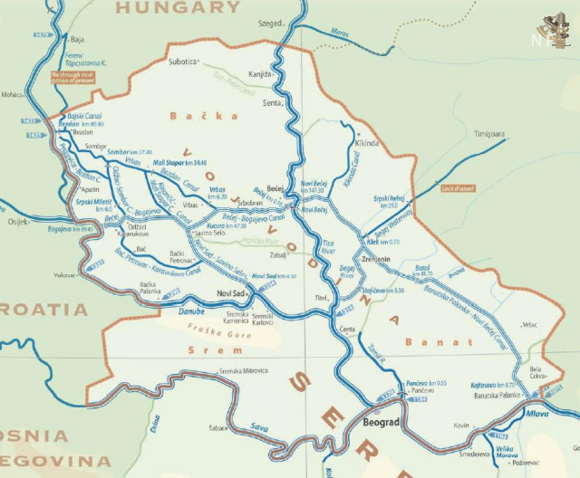
THE DANUBE-TISZA-DANUBE HYDRO SYSTEM
total length 960 km
of which 600 km navigable
25 sluices
17 ship locks
5 pumping stations
84 bridges
Strengthening of master curricula in water resources management
for the Western Balkans HEIs and stakeholders
www.swarm.ni.ac.rs

Slide 8
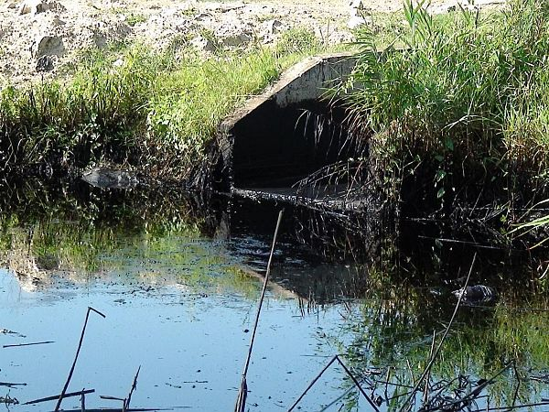
WATER PROTECTION
There are 497 registered
water polluters on the territory of Vojvodina. Wastewater is treated by 71 of them
210 polluters in the DTD hydro
system which annually discharge about
26,500,000 m3 of wastewater
(approximately 10.5 million m3 is treated water)
According to our data, in the
Danube, Sava and Tisza River
flows about 61,417,430 m3 waste
water per year, of which about
2,000,000 m3 is treated waste water
Strengthening of master curricula in water resources management
for the Western Balkans HEIs and stakeholders
www.swarm.ni.ac.rs

Slide 9
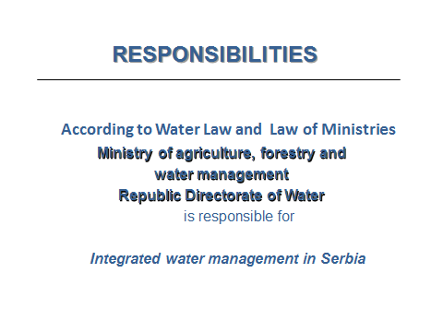
Strengthening of master curricula in water resources management
for the Western Balkans HEIs and stakeholders
www.swarm.ni.ac.rs

Slide 10
Other ministries responsible for certain aspects of water management are:
- Ministry of environmental protection
- Ministry of Health
- Ministry of Construction, Transport and Infrastructure
- Ministry of Public Administration and Local Self-Government
- etc.
Strengthening of master curricula in water resources management
for the Western Balkans HEIs and stakeholders
www.swarm.ni.ac.rs

Slide 11
STRATEGIC PLANNING DOCUMENT OF THE WATER SECTOR
Strategy of water management on the territory of the Republic of Serbia until 2034
was adopted by the Government of the Republic of Serbia, published in the Official Gazette of RS, no. 3/2017
Strengthening of master curricula in water resources management
for the Western Balkans HEIs and stakeholders
www.swarm.ni.ac.rs

Slide 12
EVALUATION OF THE CURRENT SITUATION
Advantages:
Over 90% of the territory of the Republic of Serbia has a share in the Danube River Basin.
Serbian public water management companies are willing to facilitate the operational implementation of water management responsibilities and activities.
A water infrastructure has been built up to a significant extent, estimated value of about € 14 billion
Numerous technical and other faculties provide a satisfactory level of knowledge and, with up-to-date programs and teaching methods, including postgraduate studies, can provide even better quality of professional and scientific staff
Strengthening of master curricula in water resources management
for the Western Balkans HEIs and stakeholders
www.swarm.ni.ac.rs

Slide 13
Disadvantages:
Investments in the water sector have been significantly reduced (around 300-350 million euros), which is several times lower than the required volume.
Due to lack of investments the sector has been threatened in terms of:
• flood protection: floods in plain and lowland areas, flash floods, erosion;
• water quality for domestic use and water quality protection
• water shortage, etc.
Inadequate maintenance of water/hydro systems and structures
Republic Directorate for Water does not have the capacity to meet all obligations stipulated by the Water Law and other regulations.
Insufficient number of projects involved in finding and obtaining international funds.
Surface and ground water monitoring does not provide sufficient data for rational and efficient water management with the objective to meet the EU water regulations.
Insufficient inclusion of scientific and research organizations into significant water management activities.
Strengthening of master curricula in water resources management
for the Western Balkans HEIs and stakeholders
www.swarm.ni.ac.rs

Slide 14
THE CONCEPT OF INTEGRAL WATER MANAGEMENT
Achieving integral water management, that is, a coordinated water regime throughout the Republic of Serbia and ensuring that such water management includes fair implementation of financial and social aspects including the awareness regarding the environmental protection and ecosystem improvement while adhering to international agreements represents a long-term strategic goal which requires the following:
- significant amount of time (over two decades, with an adequate approach)
- substantial investments (approximately EUR 1 billion annually).
- increased human resource capacity (operational and professional)
Strengthening of master curricula in water resources management
for the Western Balkans HEIs and stakeholders
www.swarm.ni.ac.rs

Slide 15
GOALS, WATER USE
Water use - Water supply
increasing the coverage of public water supply systems from the current 81% to 93% at the end of the planning period;
ensuring a stable supply of water of required quality and reducing the risk of interruption of water supply in excessive and emergency conditions;
reduction of unqualified water in public water supply systems to around 25%;
the rational use of water, with the gradual achievement of the economic price of water;
protection of sources (determination of sanitary protection zones), research, protection and conservation of water resources;
Strengthening of master curricula in water resources management
for the Western Balkans HEIs and stakeholders
www.swarm.ni.ac.rs

Slide 16
Provision of sufficient quantities of water for irrigation of 250,000 to 350,000 ha of agricultural land from I and II part of the development group by the end of the planning period (revitalization of existing systems to about 100,000 ha and construction of new on the surface of 150,000 to 250,000 ha);
The rational use of water, the application of adequate consumption norms for individual seed cultures and the education of farmers on modern irrigation techniques, the possibilities of drought protection, the way of association and placement of products.
GOALS, WATER USE - IRRIGATION
Strengthening of master curricula in water resources management
for the Western Balkans HEIs and stakeholders
www.swarm.ni.ac.rs

Slide 17
- in accordance with environmental conditions i.e. with minimum of hydromorfological alterations
- the exploitation of the river deposits is primarily directed to the preservation and / or improvement of the water regime, and conditioned by the smallest disturbance of the aquatic and coastal ecosystems
RESTORATION OF WATERCOURSES
Strengthening of master curricula in water resources management
for the Western Balkans HEIs and stakeholders
www.swarm.ni.ac.rs

Slide 18
GOALS, FLOOD PROTECTION
- reducing damage and flood risk
- upgrading, reconstruction and regular maintenance of protective water facilities
- active protection measures
- adequate use of aquatic land and potentially flooded zones;
- the most vulnerable facilities, plants and installations, which are of particular importance for the security of the population must be set up from the risk area
Strengthening of master curricula in water resources management
for the Western Balkans HEIs and stakeholders
www.swarm.ni.ac.rs

Slide 19
GOALS, WATER PROTECTION
OUR GOAL
Increasing the number and efficiency of waste water treatment plants
OUR MISSION
To protect and preserve surface water resources, to protect against polluters and provide a safe and reliable water use for population,agriculture and economy as well as recreational use of rivers and canals.
Strengthening of master curricula in water resources management
for the Western Balkans HEIs and stakeholders
www.swarm.ni.ac.rs

Slide 20
THE MOST IMPORTANT ACTIVITIES NEEDED FOR WATER MANAGEMENT
The precondition for achieving long-term and strategic goals in all water areas and branches is to establish an appropriate water management system, which includes:
Completion of legal regulations, i.e. adoption of bylaws in accordance with the Law on Waters (including amendments to this document in the process of harmonization with EU regulations);
Planning documents in the field of water management is required;
Strengthening the institutional capacity of the water sector.
Strengthening of master curricula in water resources management
for the Western Balkans HEIs and stakeholders
www.swarm.ni.ac.rs

Slide 21
Thank you for your attention!
Strengthening of master curricula in water resources management
for the Western Balkans HEIs and stakeholders
www.swarm.ni.ac.rs

